Slide 1
Predictive Modeling for Diabetes Risk
Using Machine Learning
Akwawo Ekpu and Aashi Vishnoi
BCH 339N
November 29th, 2023

Slide 2
Overview
Background
Objective
Dataset
Risk Factors
Comparing Models
Limitations & Improvements
Conclusion

Slide 3
Background Information
Diabetes - chronic disease where individuals lose their ability to regulate levels of glucose. There are two types of diabete Type 1 and type 2.
Type 1 - the pancreas does not produce insulin
Type 2 - the pancreas makes less insulin and body becomes resistant
Diabetes is a very complicated condition which may be caused by many given factors
Additionally there is no cure.
CDC (2018) - 34.2 million individuals in the USA have diabetes and 88 million have prediabetes
Estimate 8 in 10 pre diabetics are unaware of their risk factors

Slide 4
Background Information
Behavioral Risk Factor Surveillance System
CDC
Health telephone survey
Data collection regarding health-related risk behaviors, chronic health conditions, and use of preventative services
Completes more than 400,000 adult interviews per year

Slide 5
Dataset
Kaggle - 2015
Original - 441,455 individuals with 330 features
Used - clean dataset with 253,680 individuals 21 features
Variable examples
Blood pressure
Difficulty walking
BMI

Slide 6
Objectives
Determine which factors are more significant/important to diabetes diagnosis
Build a predictive model to determine diabetes diagnosis using various factors
Compare models to determine which one is most efficient/effective for diagnosis prediction

Slide 7
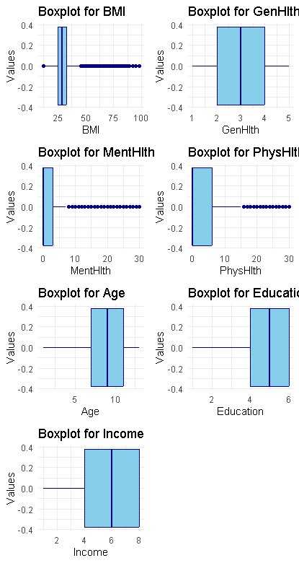
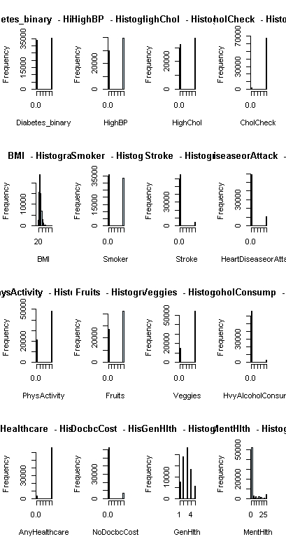
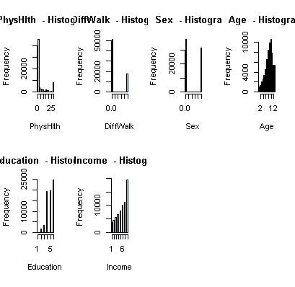
Data Visualization
No missing values
Few outliers

Slide 8
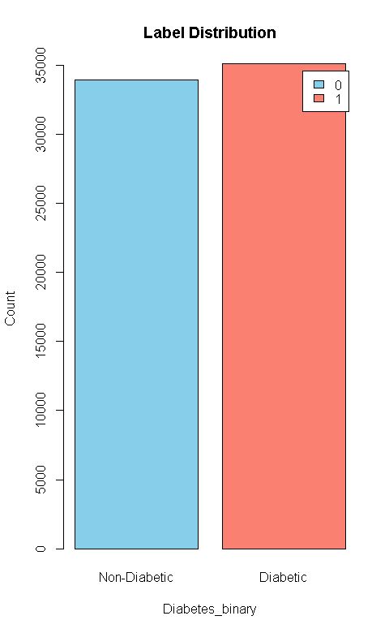
Target Variable
Outr target variable was Diabetes _binary which basically describes if you have diabetes .
Yes= 1 , No = 0
We saved zeros in Non- Diabetic and the 1 in diabetic ]
Even distribution

Slide 9
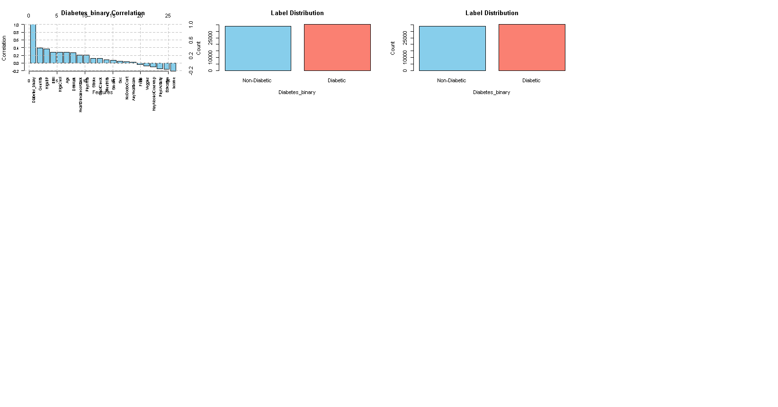
Correlation to Target Variable Diabetes_Binary

Slide 10
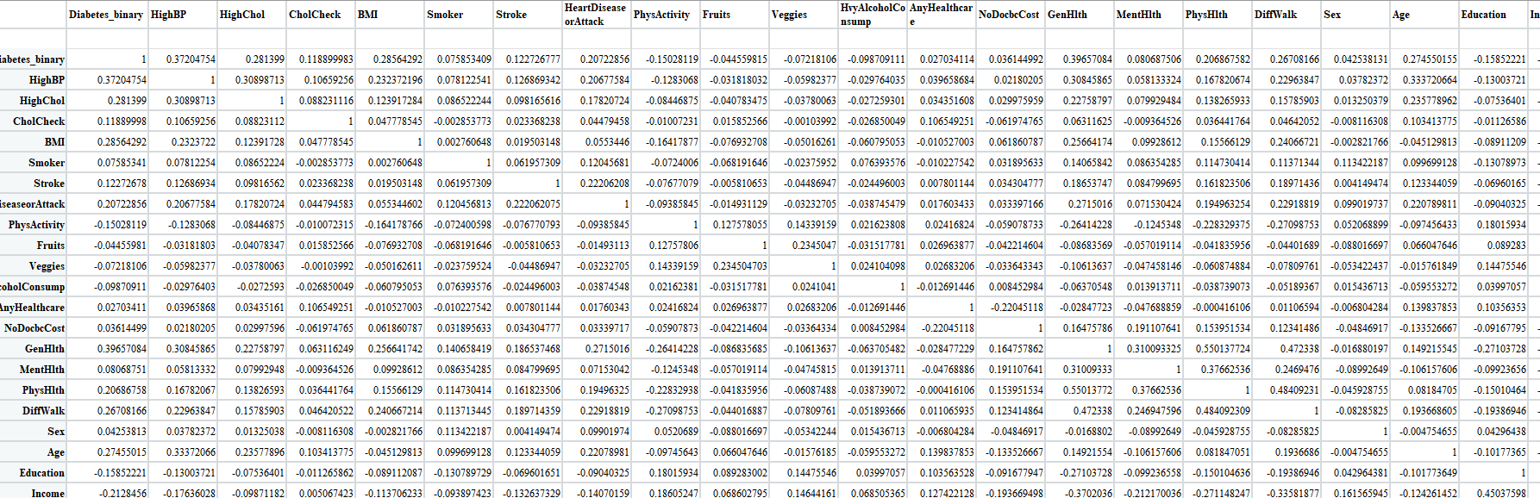
Correlation Matrix
Partial Snippet

Slide 11
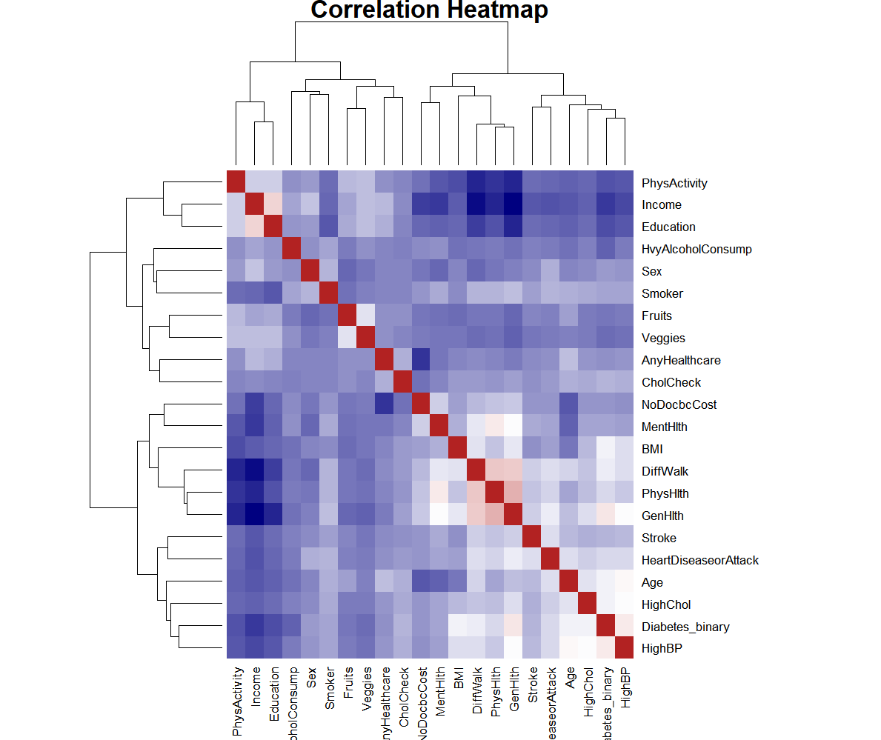
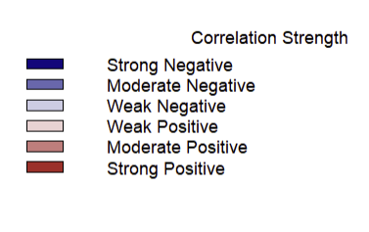
Heatmap

Slide 12
Heat Map Interpretation
Positive Correlation
Stroke
Heart Disease or Attack
Difficulty Walking
Sex
Age
Negative Correlation
Income and general health

Slide 13
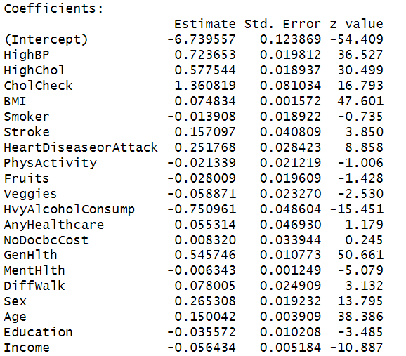
Logistic Regression Model - Greatest Risk Factors
We used the logistic regression model because our outcome is binary in nature
More likely to be associated with the likelihood of diabetes
p<0.05 = significant
BMI, GenHlth, High Blood Pressure , Heart Disease or Attack, Age
Insignificant predictors in model
Smoker, Physical Activity

Slide 14
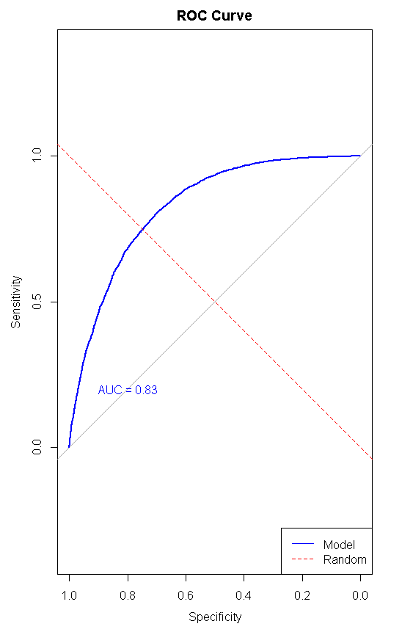
ROC/AUC Plot
Visualization of the performance of our logistic regression model
Given that :
The curve rises steeply towards hugs the upper left corner, indicating high sensitivity and low false positive rate.
1>AUC > 0.5
The accuracy of our model came out to be about 0.83
We concluded that the accuracy was good

Slide 15
Random Forest
Call:
randomForest(formula = Diabetes_binary ~ ., data = training, mtry = 4, ntree = 501, importance = TRUE)
Type of random forest: classification
Number of trees: 501
No. of variables tried at each split: 4
OOB estimate of error rate: 25.23%
Confusion matrix:
0 1 class.error
0 20218 7989 0.2832276
1 6281 22065 0.2215833
This learning method that is used for both classification and regression tasks. We choice this method:
Can be used for both classification and regression task
It design for predicting categorical outcomes
Less prone to overfitting
Accuracy = 0.7471742

Slide 16
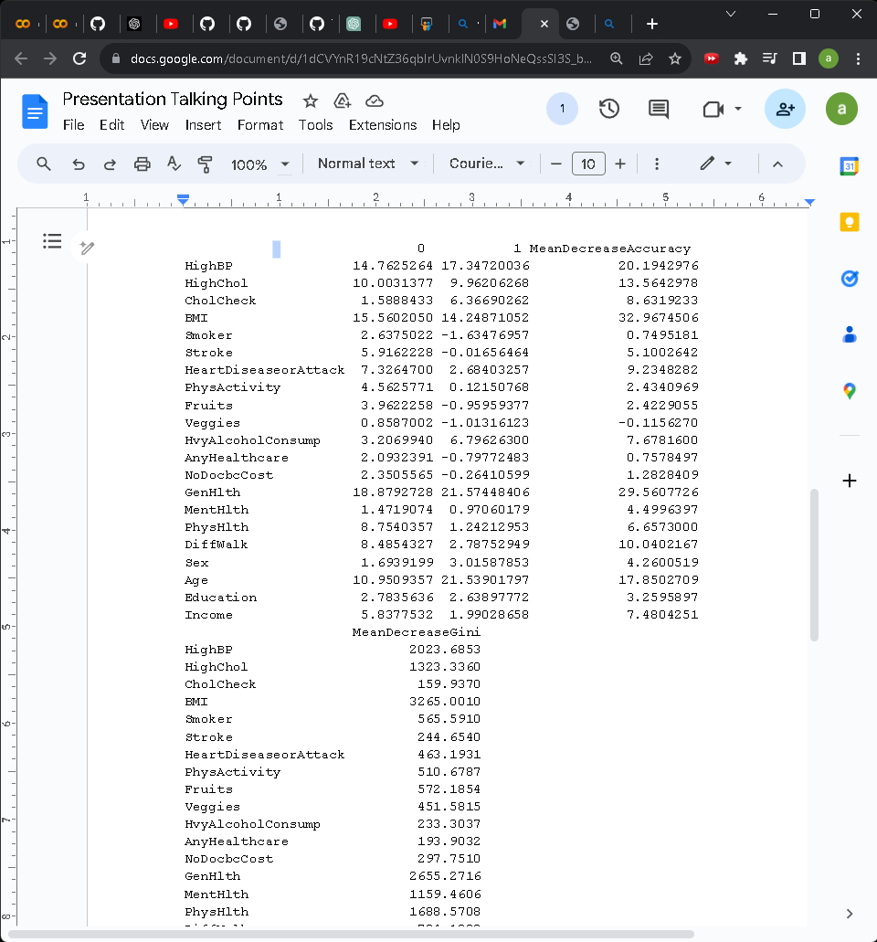
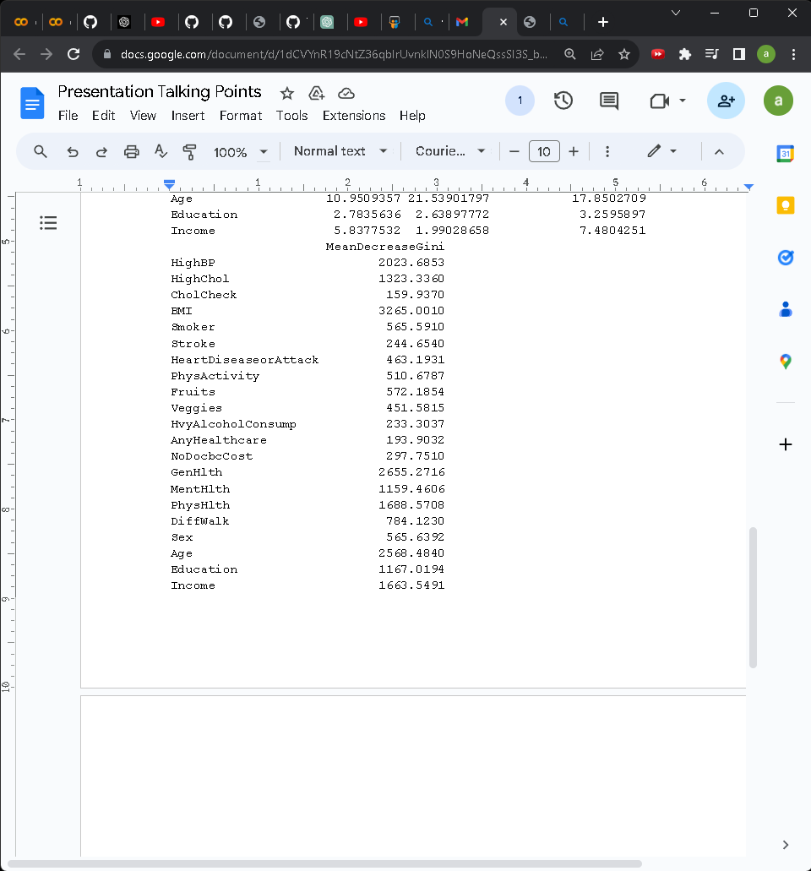
Random Forest

Slide 17
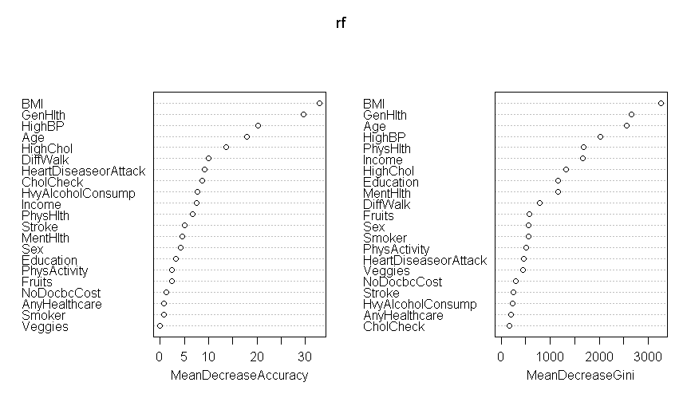
Random Forest : Feature Importance

Slide 18
Comparing Models
Models Accuracy Score
Logistic Regression 0.83
Random Forest 0.7471742
Best performing model was Logistic Regression with a score of 0.83

Slide 19
Limitations & Improvements
Limitations
Selection bias - telephone interviews
Self reported data by individuals
Class imbalances
Improvements for Future Iterations
Increasing the number of trees
More representative data collection
Better handling of class imbalances
Introduce weighted classes - support underrepresented groups
Test scalability across years

Slide 20
Conclusion
Significant factors that influence diabetes in the models:
BMI
General Health
High Blood Pressure
Age
Best performing/highest scoring model was Logistic Regression with a score of 0.83

Slide 21
References
Centers for Disease Control and Prevention. (2023, September 5). What Is Diabetes? Centers for Disease Control and Prevention. https://www.cdc.gov/diabetes/basics/diabetes.html
“Introduction to Random Forest in R.” Simplilearn.com, www.simplilearn.com/tutorials/data-science-tutorial/random-forest-in-r.
UVA Health. (n.d.). Types of Diabetes. Retrieved from https://uvahealth.com/services/diabetes-care/types
Fregoso-Aparicio, L., Noguez, J., Montesinos, L., & Garc&iacute;a-Garc&iacute;a, J. A. (2021, December 20). Machine learning and deep learning predictive models for type 2 diabetes: A systematic review - diabetology & metabolic syndrome. BioMed Central. https://dmsjournal.biomedcentral.com/articles/10.1186/s13098-021-00767-9
Nayak, L. (2022, March 22). Predicting diabetes with random forest classifier. Medium. https://towardsdatascience.com/predicting-diabetes-with-random-forest-classifier-c62f2e319c6e
What is logistic regression?. IBM. (n.d.). https://www.ibm.com/topics/logistic-regression
‌

